Slide 1
ANESTHESIA MONITOR
TIME SERIES ANALYZER EEG Data
Chrystinne Fernandes
Diénert Vieira

Slide 2
01
02
03
04
Motivation
Dataset Preparation
Statistical and ML Models
Conclusion
Problem
Solution
Dataset
Selection
Subsampling Splitting
ARIMA
KNR
SVR
MLP
Results
Comparison between models

Slide 3
Motivation
01
Why medical teams should continuously monitor the
patient’s Depth Of Anesthesia?

Slide 4
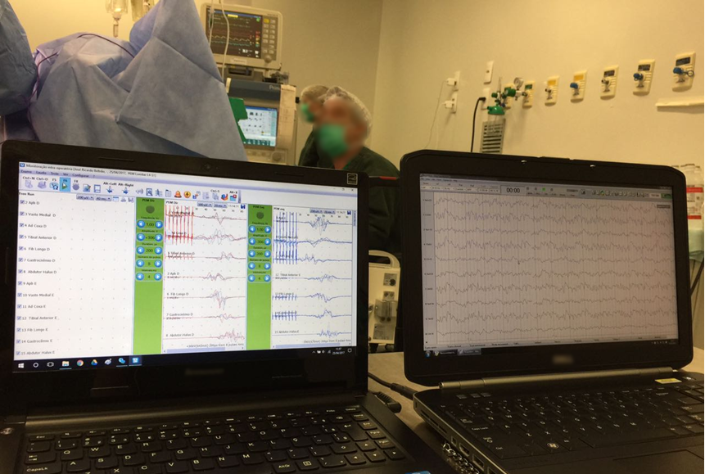
DEPTH OF ANESTHESIA
Three pillars:
Analgesia;
Immobility;
Unconsciousness.

Slide 5
02
Data Preparation
Selection, Subsampling and Splitting

Slide 6

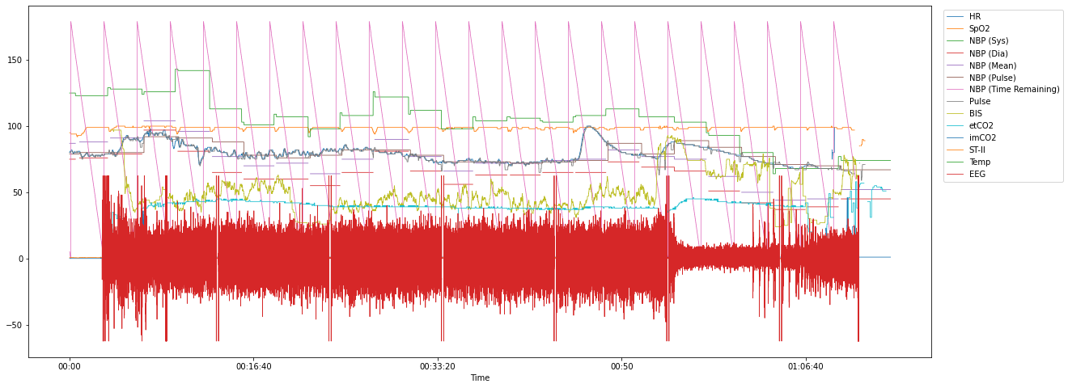
Main Vital Signs - Case 28
EEG Selection
Link: https://outbox.eait.uq.edu.au/uqdliu3/uqvitalsignsdataset/index.html

Slide 7
Subsampling

Slide 8
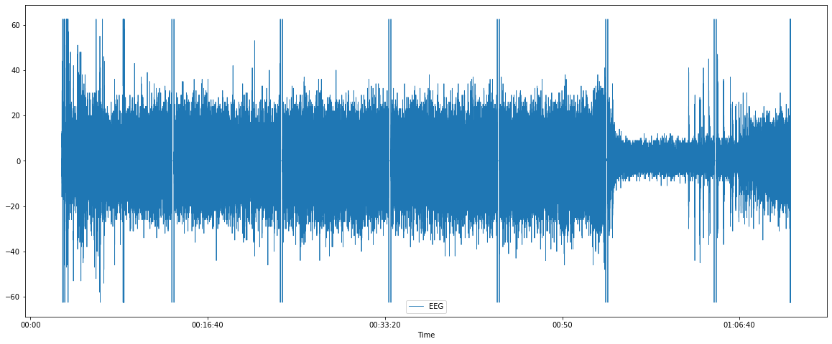
EEG Full samples:
10 ms frequency - 446.111 points

Slide 9
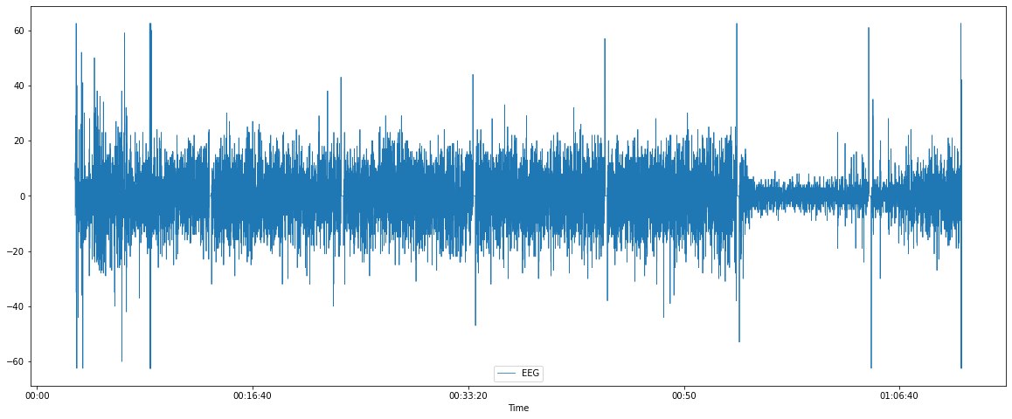
EEG Subsampled:
300 ms frequency - 14.871 points

Slide 10
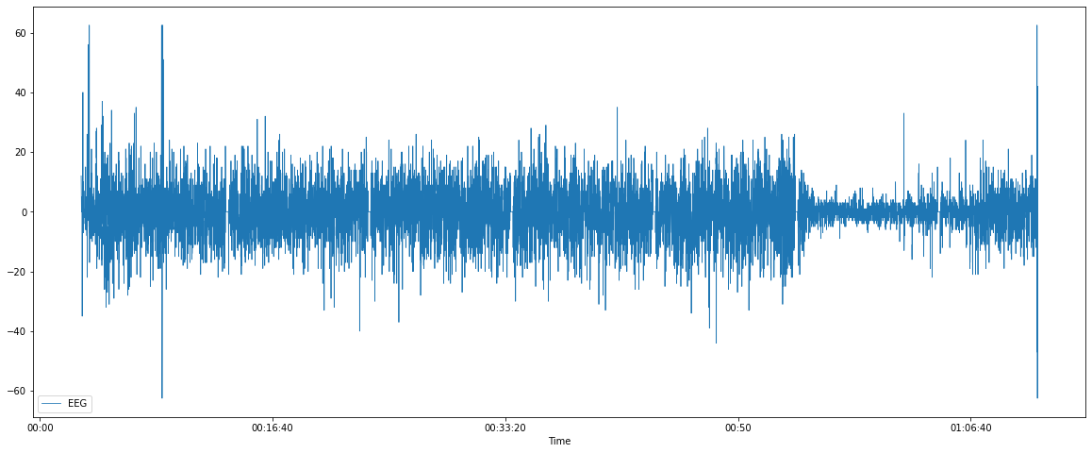
EEG Subsampled:
500 ms frequency - 8.923 points

Slide 11
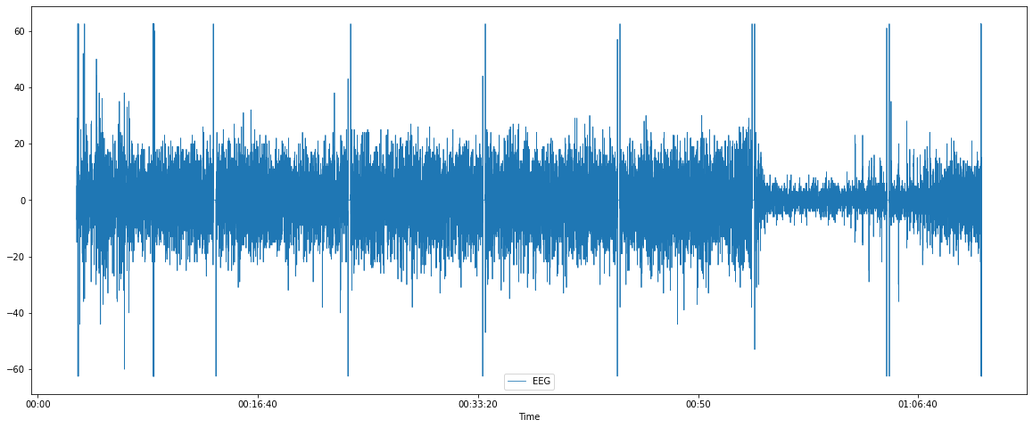
Chosen frequency:
200 ms - 22.306 points

Slide 12
Splitting

Slide 13
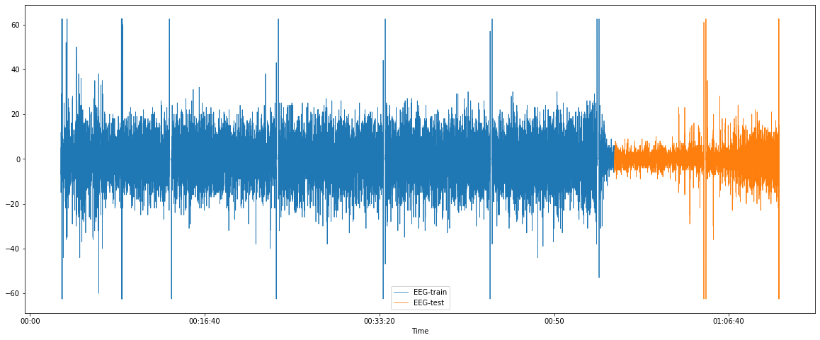
200 ms frequency
Train (75%) and Test (25%) Split, Val (Later)

Slide 14
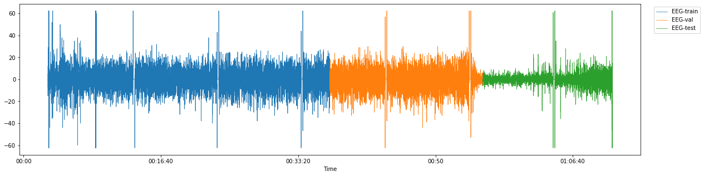
200 ms frequency
Train (50%), Val (25%) Test (25%) Split

Slide 15
03
Statistical and ML models
ARIMA, KNR, SVR, MLP

Slide 16
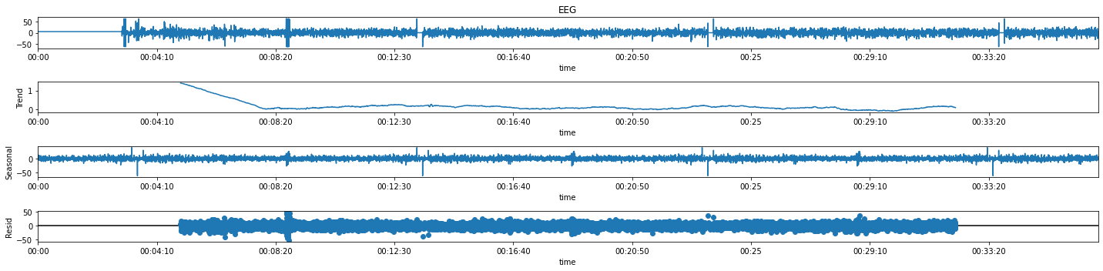
Decomposition
Period: 10 minutes sazonality

Slide 17
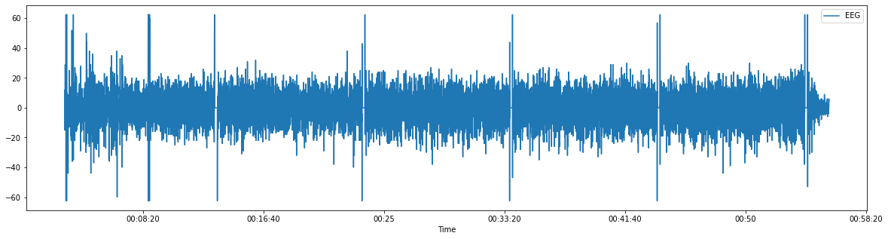
Moving Average

Slide 18
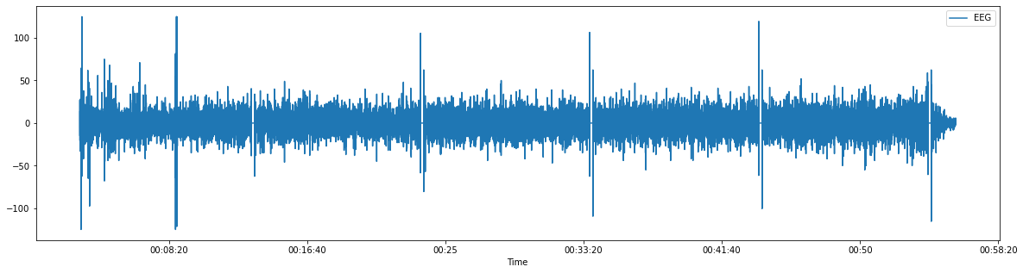
Moving Average D1

Slide 19
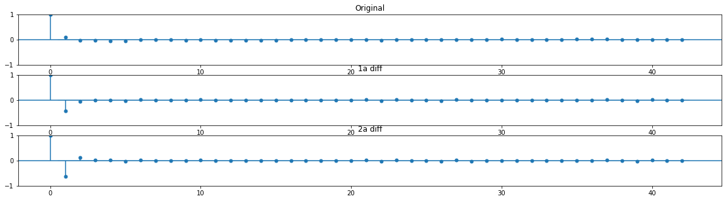
ACF

Slide 20
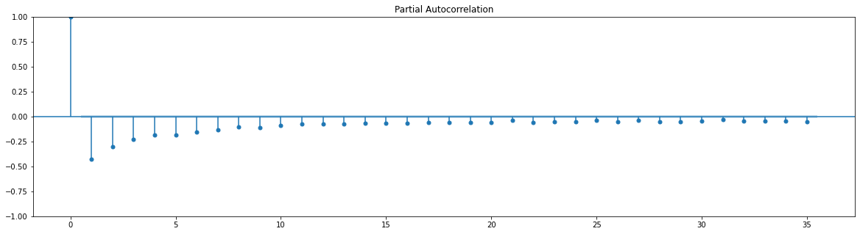
Partial ACF

Slide 21
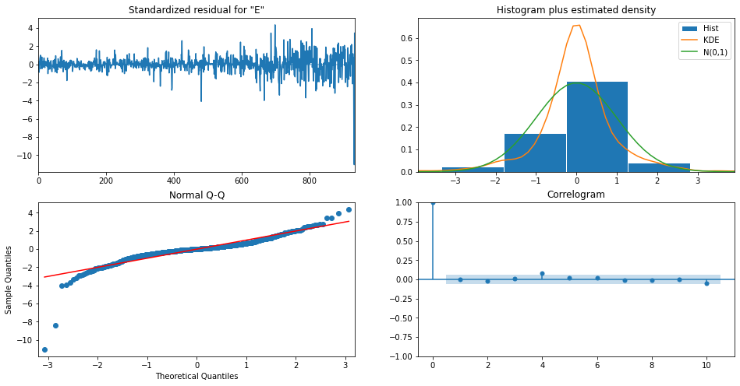
Diagnostics

Slide 22
ARIMA

Slide 23
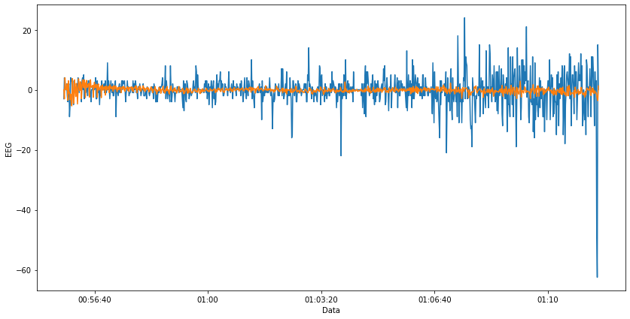
Arima - Test Prediction

Slide 24
KNN

Slide 25
KNR:
Hiperparameters Distributions
'n_neighbors':
[int(x) for x in np.linspace(start = 1, stop = 1000, num = 100)],
'weights':
['uniform', 'distance']

Slide 26
Ground Truth

Slide 27
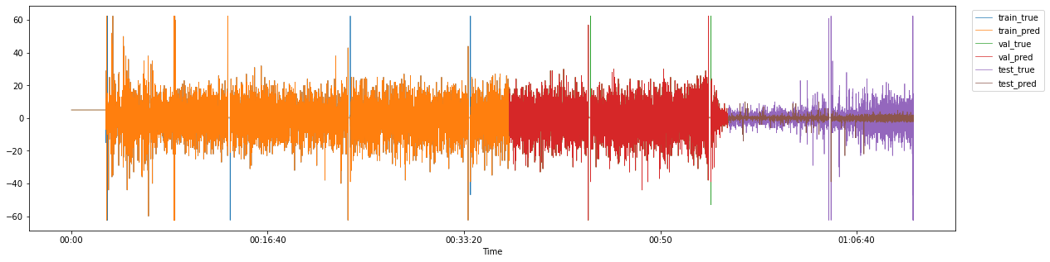
KNR - Best Result:
Train, Val and Test Predictions

Slide 28
SVM

Slide 29
SVR:
Hiperparameters Distributions
'C':
[x for x in np.linspace(start = 1, stop = 10, num = 100)],
'epsilon':
[x for x in np.linspace(start = .1, stop = 1, num = 100)],
'kernel':
['linear', 'poly', 'rbf', 'sigmoid']

Slide 30
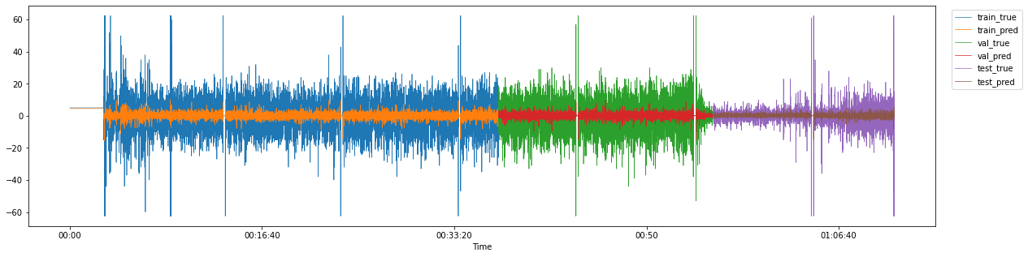
SVR - Best Result:
Train, Val and Test Predictions

Slide 31
MLP

Slide 32
MLP - Model
Architecture and Hiperparameters
class MLP(nn.Module):
def __init__(self):
super().__init__()
self.fc1 = nn.Linear(5, 100)
self.fc2 = nn.Linear(100,1)
def forward(self, X):
out = torch.tanh(self.fc1(X))
out = self.fc2(out)
return out
multi_neuron = MLP()
epochs = 1000
loss_fn = nn.MSELoss()
optimizer = optim.SGD(multi_neuron.parameters(), lr=0.01, weight_decay= 0.005)

Slide 33
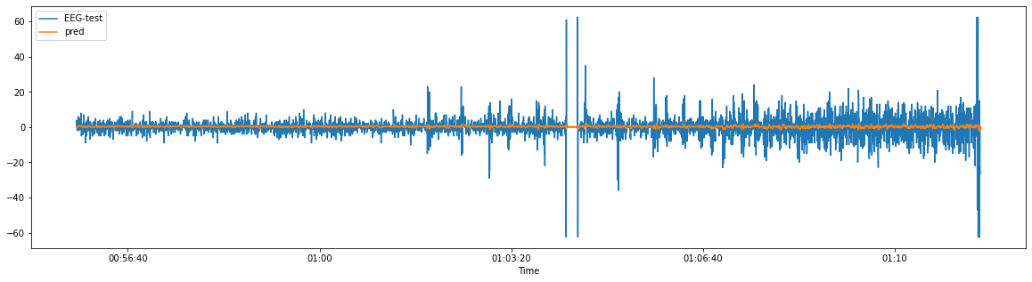
MLP - Best Result:
Test Predictions

Slide 34
Results
03
Comparison between models

Slide 35
Validation Results
 | Repetition | R2 | MSE | MAE | Params
KNN | 4 | 0.98 | 1.44 | 0.037 | weights: distance, n_neighbors: 273
KNN-d1 | 8 | -77.53 | 177.35 | 10.01 | weights: distance n_neighbors: 223
SVR | 9 | -29.12 | 84.46 | 6.82 | kernel: rbf, epsilon: 0.41818181, C: 5.4545454

Slide 36
Test Results
 | R2 | MSE | MAE
KNN | -17.47 | 32.08 | 3.31
SVR | -28.09 | 32.02 | 3.29
ARIMA | -29.76 | 29.22 | 3.36
KNN-d1 | -88.46 | 177.01 | 10.01
MLP | -163.30 | 32.02 | 3.26

Slide 37
THANKS!
Any questions?
Please keep this slide for attribution.

